Slide 1
AGENDA
Reflection on last week’s material
Any Qs?
Course logistics – esp. addressing questions and concerns
Looking to this week’s material & assessments
Small group discussions!

Slide 2
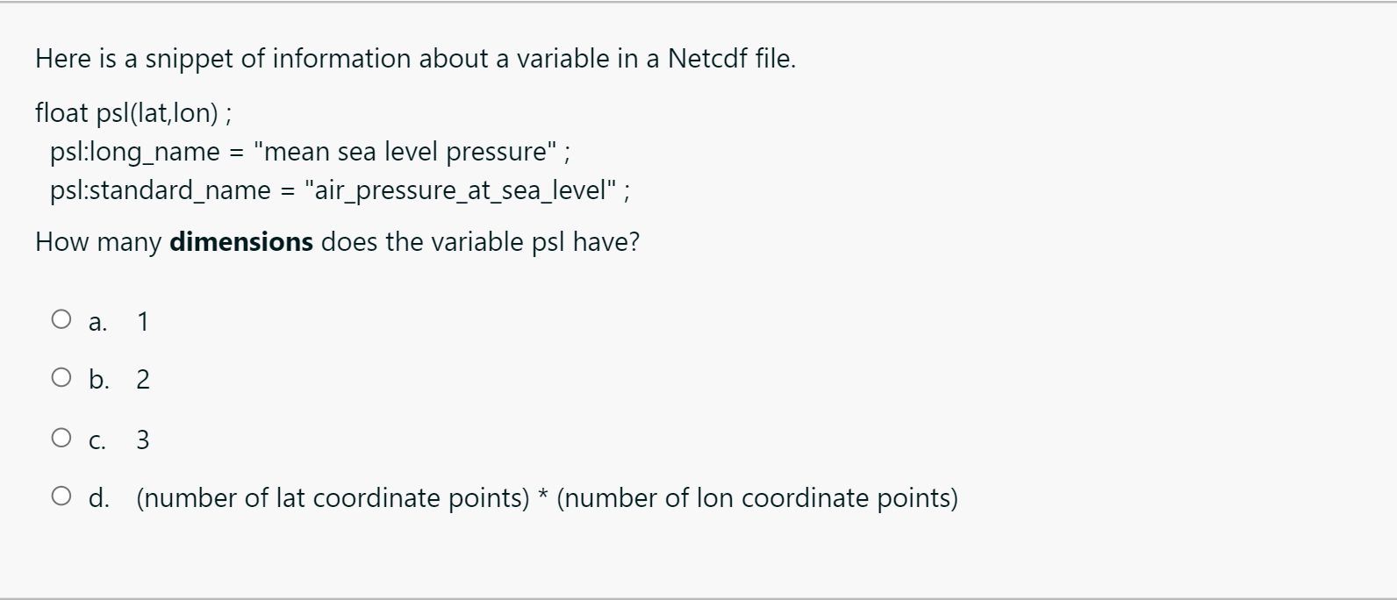
REFLECTION ON LAST WEEK’S MATERIAL
Questions from you?
Check out your grades/feedback on Assignment #1 and Quiz #1!
Quiz:
How many dimensions?
See Lesson ‘Data Components’ in Week 1 for info about dimensions
Two dimensions here – lat and lon

Slide 3
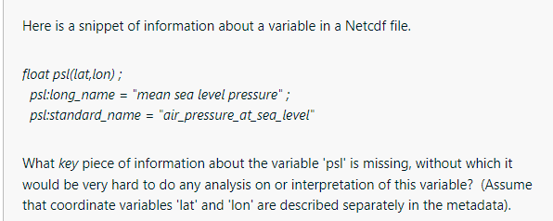
REFLECTION ON LAST WEEK’S MATERIAL
Questions from you?
Check out your grades/feedback on Assignment #1 and Quiz #1!
Quiz:
What is missing?
Missing: units
Also accepted: time dimension

Slide 4
REFLECTION ON LAST WEEK’S MATERIAL
Quiz, cont’d:
Interesting perspectives on data ethics, data errors + reproducibility!
Quizzes + Homeworks: make sure you’re answering questions fully
Assignment:
V. thoughtful data science ethical scenarios + examples of data collected on you!

Slide 5
Do you want….additional supplements/tutorials/resources beyond our lessons and the recommended readings?
PLEASE SEE THE ‘PYTHON, STATISTICS, AND DATA SCIENCE RESOURCE TAB’ ON MOODLE

Slide 6
RECOMMENDED BREAKOUT ROOM PRACTICES
Cameras on if you feel comfortable
Everyone gets an opportunity to discuss – preferably verbally, but also leverage chat as needed
Feel free to screen share (especially in later labs when you work collaboratively on code)

Slide 7
DATA ETHICS REMINDERS
Topic that isn’t talked about enough in data-intensive fields and courses!
You’ll be asked to consider any ethical considerations for the data and algorithms you use for your projects!
Data ethics considerations = so much more than using data collected about humans in unethical ways

Slide 8
GROUP DISCUSSION TIME!
Objectives: critically evaluate and discuss real-life data ethics scenarios

Slide 9
IN YOUR BREAKOUT ROOMS, DISCUSS
Okcupid data ethics scenario
Additional philosophical data ethics take: https://points.datasociety.net/okcupid-data-release-fiasco-ba0388348cd
The data ethics scenarios you found!
How is data collected on you? (If time permits)

Slide 10
LOOKING AHEAD TO THIS WEEK’S MATERIAL

Slide 11
MOVING FORWARD:
Be sure to ASAP: join the class Slack, make sure you get announcements that I send from Moodle
Stay tuned this week: further details on project, including examples of the types of project students have previously done
Next synchronous session, come ready to discuss:
data errors
good coding practices!

